Slide 1

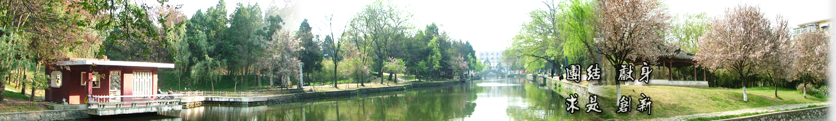
1 INTRODUCTION
EOE Postgraduate Courses
Multi-sensor Data Fusion
王晶琦
wangjingqi@njust.edu.cn

Slide 2
Introduction to the course
One semester optional course for EOE postgraduates
An introduction to the theories & techniques of multi-sensor data fusion
A certain minimum level of mathematics is required (linear algebra, calculus, simple probability, etc)
Attendance: 30%, test score: 70%
Fully delivered in English

Slide 3

References
[1] H. B. Mitchell. Multi-sensor Data Fusion —— An Introduction. Springer Belin Heidelberg, Newyork. 2007.
[2] L. A. Klein. Sensor and Data Fusion. A Tool for Information Assessment and Decision Making. 2nd Edition. SPIE Press. 2012.
[3] D. L. Hall, J. Llinas. Handbook of Multisensor Data Fusion. CRC Press. 2001.
南京理工大学图书馆→馆藏资源/外文数据库→Springer电子图书全文数据库
Nanjing University of Science and Technology Library→COLLECTIONS→Database Navigation→Springer

Slide 4
Introduction of the textbook
This book has been designed as a textbook for one-semester graduate course in multi-sensor data fusion, which provide an introduction to the theories and techniques of multi-sensor data fusion.
Advantages:
The book is intended to be largely self-contained in so far as the subject of multi-sensor data fusion is concerned.
All materials are presented using a common statistical Bayesian framework.
The book provides a large number of examples and corresponding software code written in Matlab.

Slide 5
Contents
1.1 Definition of Multi-sensor Data fusion
1.2 Synergy
1.3 Multi-Sensor Data Fusion Strategies
1.4 Formal Framework
1.5 Catastrophic Fusion
1.6 Organization

Slide 6
1.1 Definition of Multi-sensor Data fusion
“the theory, techniques and tools which are used for combining sensor data, or data derived from sensory data, into a common representational format”
to improve the quality of the information ⎯ more specific or better inferences than could be achieved by using a single, independent sensor.
multiple measurements to be combined ⎯ may be produced by multiple sensors, or by one sensor at different time instants.
determining the best procedure for combining the multi-sensor data ⎯ e.g. a statistical approach with explicit probabilistic models employed to describe the various relationships between sensors considering the underlying uncertainties.

Slide 7
1.2 Synergy
Synergy (协同作用) is a process to improve the quality of the information output.
Synergistic effect: increased spatial and temporal coverage, increased robustness to sensor and algorithmic failures, better noise suppression and increased estimation accuracy.
Eg.1.1 Multiple Camera Surveillance Systems
the surveillance of a wide-area urban site may be provided by periodically scanning the area with a narrow field-of-view camera
by using multiple cameras, the mean time between scans be reduced, and thereby the temporal coverage be increased
Eg.1.2 Multi-Modal Biometric Systems
A single biometric trait is lack of completeness or universality→high error rates
non-universality problem can be solved by fusing the evidence obtained from multiple traits→multi-modal biometric sensor system

Slide 8
Four ways to improve performance of a data fusion system
Representation: higher abstract level or granularity (粒度)→ provide a richer semantic on the data.
Certainty: the gain in certainty achieved with growth in data probability
Accuracy: smaller standard deviation; the gain in accuracy and the gain in certainty are correlated.
Completeness: new information allows more complete view on the environment; the redundant and concordant information leads to a gain in accuracy.
Eg.1.3 Multi-Modal Medical Imaging: Gain in Completeness.
images obtained through Magnetic Resonance Imaging (MRI), Computed Tomography (CT) and Positron Emission Tomography (PET).
to allow a surgeon to view “soft tissue” information (MRI) in the context of “bone” (CT) and in the context of “functional” or “physiological information” (PET).

Slide 9
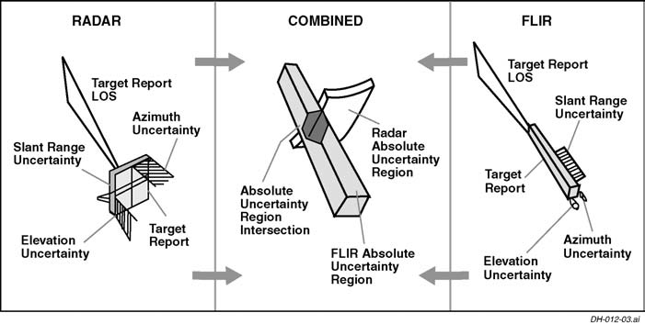
E.g. A moving object observed by both a pulsed radar and an infrared imaging sensor

Slide 10
1.3 Multi-Sensor Data Fusion Strategies
Multi-sensor data fusion is a wide-ranging subject with many different facets.
Classify data fusion system from three different points of view:
Fusion type : according to what aspect of the system is fused (Boudjemaa and Forbes [27])
Sensor configuration: according to the sensor configuration (Durrant-Whyte [69] )
Input/Output Characteristics: according to the joint input/output characteristics (Dasarathy [56])

Slide 11
1.3.1 Fusion type
Fusion across sensors: a number of sensors nominally measuring the same property.
Fusion across attributes: measuring different quantities associated with the same experimental situation, as, for example, in the measurement of air temperature, pressure and humidity to determine air refractive index.
Fusion across domains: measuring the same attribute over a number of different ranges or domains. This arises, for example, in the definition of a temperature scale.
Fusion across time: current measurements fusing with historical information.
E.g. 1.4 Flood forecasting.
reduce the frequency of combined sewer overflows to natural water courses from urban drainage systems (UDS)→accurate real-time estimates of the rainfall.
fuse measurements of the rainfall made by ground-based rain gauges and a weather radar system.
two sensors measure the same property →“fusion across sensors”

Slide 12
1.3.2 Sensor configuration
Complementary : the sensors do not directly depend on each other, but can be combined in order to give a more complete image of the phenomenon under observation.
- Complementary sensors help resolve the problem of incompleteness.
Competitive. Each sensor delivers an independent measurement of the same property.
- to reduce the effects of uncertain and erroneous measurements.
Cooperative. using the information provided by two, or more, independent sensors to derive information that would not be available from the single sensors.

Slide 13
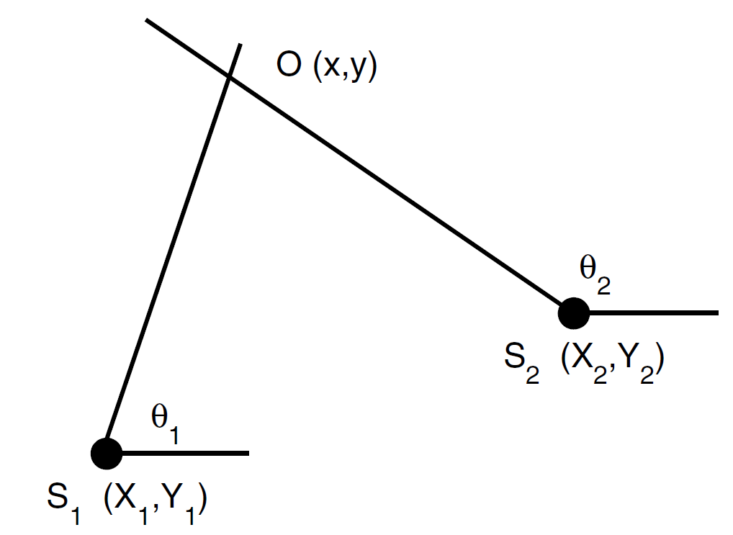
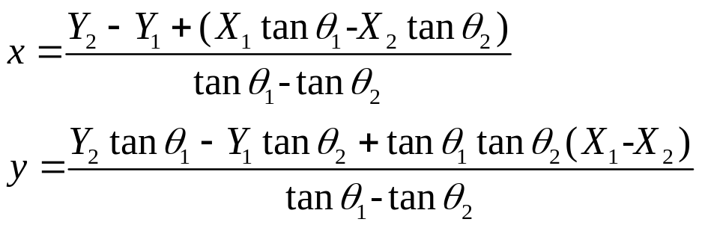
Example 1.5. Triangulation
An object O : (x,y);
Two direction- finding sensors:
S₁ and S₂: (X₁, Y₁) and (X₂, Y₂)

Slide 14
1.3.3 Input/Output Characteristics
Table 1.1. Dasarathy’s Input/Output Data Fusion Model.
Symbol | Name | Description/Example
DaI-DaO | Data Input/Data Output | Input data is smoothed/filtered.
DaI-FeO | Data Input/ Feature Output | Features are generated from the input data e.g. edge detection in an image.
FeI-FeO | Feature Input/ Feature Output | Input features are reduced in number or new features are generated by fusing input features.
FeI-DeO | Feature Input/ Decision Output | Input features are fused together to give output decision.
DeI-DeO | Decision Input/ Decision Output | Multiple input decisions are fused together to give a final output decision.

Slide 15
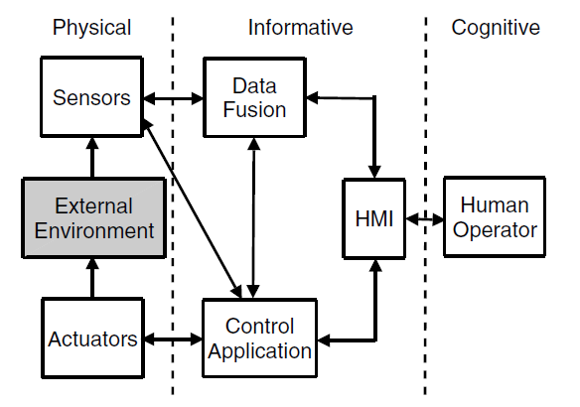
1.4 Formal Framework
Providing a structured framework;
decreasing the system design complexity by compartmentalizing the design problem.
helping in the system construction and maintenance
Three parts:
Physical Domain: Hardware
Information Domain: Software
Cognitive Domain: Human user.

Slide 16
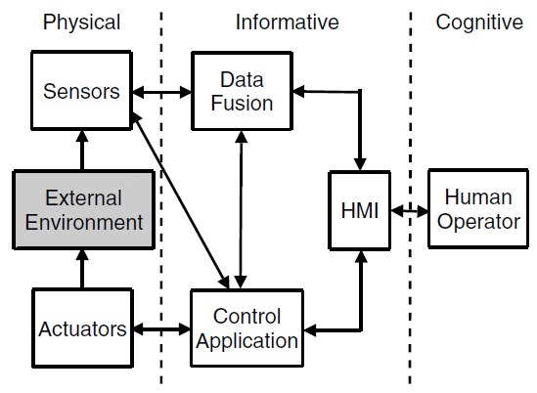
Physical Domain: Hardware
the sensor modules representing sensors which physically interact with the external environment.
a sensor model providing a description of the measurements made by the sensor and of the local environment.
actuators to physically change the external environment.
Information Domain: Software
the heart of a data fusion system, containing three blocks : data fusion, control application/ resource management and human-machine interface (HMI).
data fusion ⎯ combine all the sensor data into a unified view of the environment in the form of an “environmental image”.
control application ⎯ all decisions made on the basis of the environmental image (“sensor management”)

Slide 17
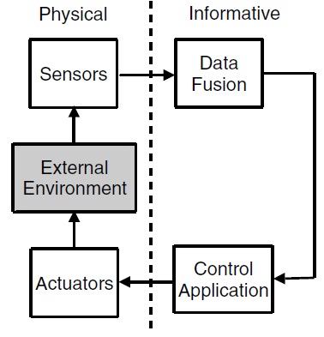
Cognitive Domain: Human User
the final arbiter or decision maker
all the information transmitted to the human user is transformed into a form which is intuitively usable by the user for his decision-making process.
Example 1.6. Control Loop
a control loop: sensor, actuator, data fusion and control application.
①environment observed with one or more sensors.
②corresponding sensor observations passed to the data fusion block and be combined to form a unified view of the environment (“environmental image”).
③environmental image passed to the control application block.
④ feed the decisions made by the control application block to the environment
— loop is closed!

Slide 18
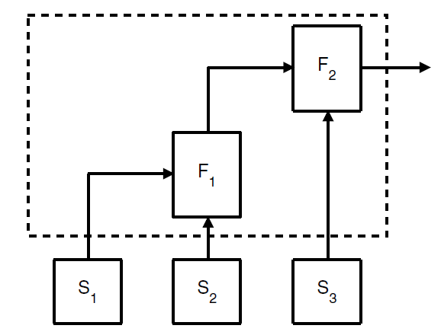
1.4.1 Multi-Sensor Integration
only a few of the autonomous modules performing “multi-sensor data fusion”, the remaining modules performing auxiliary functions.
to differentiate between multi-sensor data fusion performed by the individual modules and multi-sensor data integration performed by the entire data fusion block.
F₁ performs data fusion on the output of sensors S₁ and S₂
F₂ performs data fusion on the output of F₁ and the sensor S_{3.}
Together F₁ and F₂ perform “multi-sensor integration”.
Fig. 1.4. Shows two multi-sensor data fusion blocks F1 and F2.

Slide 19

1.5 Catastrophic Fusion
Catastrophic Fusion
the performance of a multi-sensor data fusion system F is significantly lower than the performance of one, or more, of the individual sensors S_{m}.
In general, each sensor S_{m}, m ∈ {1, 2, . . .,M}, is designed to operate correctly only under specific conditions, or environment, C_{m}.
Let C_{F} denote the corresponding condition for the correct operation of all the sensors in system F, then C_{F} is the “intersection” of the C_{m} which we may write symbolically as
(1.1)
When F is used in an environment C, which is inconsistent with one of the Cm, say Cm∗ , the corresponding signal, Sm∗, may dominant the fused output with catastrophic results.
→ secondary classifiers

Slide 20
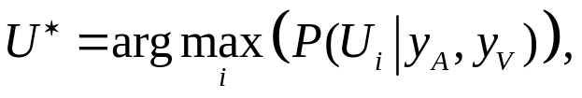

Secondary Classifiers
To monitor the performance of each sensor S_{m}.
E.g.1.7. Automatic Speech Recognition: Preventing Catastrophic Fusion.
using a single audio sensor S_{A}, a substantial reduction in performance when background noise, channel distortion or reverberation are present.
Audio-visual system: employ an audio sensor S_{A} and a visual sensor S_{V}. The two sensors are complementary.
Given a finite set of utterances U_{i}, i ∈ {1, 2, . . .,N}, we identify an unknown utterance, U, as
(1.2)
To a first approximation, the audio and visual features are conditionally independent,
(1.3)
P(U_{i}|y_{A}) and P(U_{i}|y_{V}) are calculated off-line using a set of training samples D.
The solution from (1.2) and (1.3) is theoretically optimal when the samples and test samples are well matched.

Slide 21

When the samples and test samples are not matched, a weighted integration scheme is used to attenuate the inﬂuence of the noisy channel.
This weighting can be a function of the signal-to-noise ratio (SNR) in each channel, and can be implemented as follows:
(1.4)
The purpose of the weights(α_{m}, m∈A,V) is to “neutralize” a sensor S_{m} , whenever the secondary classiﬁers determine that S_{m} is operating outside its speciﬁed operating conditions C_{m} .
worst case:
environmental conditions make the sensor completely unreliable
→set the corresponding weight to zero.

Slide 22
1.6 Organization
Part I: Introduction. Chapts. 1-3.
Chapt.1: an overview of the basic concepts in multi-sensor data fusion.
Chapt.2: “sensors”, the source of all input data into a data fusion system.
Chapt.3: different system architectures which may be employed in constructing a data fusion system.
Part II: Common Representational Format . Chapts. 4-7.
Chapt.4: an overview of the basic concept of a common representational format and the different techniques used to create such a representation.
The techniques divided into three different types are discussed in turn in Chapts. 5, 6 and 7.

Slide 23
Part III: Data Fusion. Chapts. 8-13.
Chapt.8: an overview of the Bayesian approach to multi-sensor data fusion and the different techniques involved.
Chapts. 9-11: parameter estimation theory including sequential estimation theory.
Chapts. 12-13: decision fusion.
Part IV: Sensor Management. Chapt. 14
Sensor management. Specifically we consider how the decisions made by the data fusion block may, if required, be fed back to the sensors.
Part V: Appendices. Appendices A and B.
Appendix A : a list of relevant software written in matlab which is available on the world wide web.
Appendix B: a summary of elementary results in probability theory, linear algebra and matrix theory.

Slide 24

Thank you for your attention!
Notes:
1. Now, I’m going to call the roll. Expect you to reply when I call your name.
2. Grab a piece of paper, and write down your name and student number on it, and also, a sentence about this lecture. Anything would be ok. E.g. how much percentage that you understand, and anything you would like me to improve. English or Chinese, both ok! Consider it as a roll-called.

